Slide 1
Chapter 4: Multivariate state-space models for animal movement

Slide 2
Multivariate models
Discretization
[Discuss examples]

Slide 3
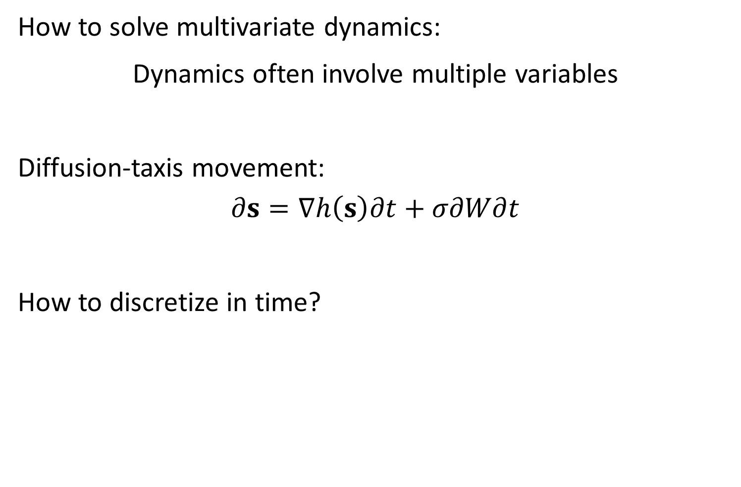
Multivariate models
How to solve multivariate dynamics:
Dynamics often involve multiple variables
Diffusion-taxis movement:
$$∂s=∇h\left(s\right)∂t+σ∂W∂t$$
How to discretize in time?

Slide 4
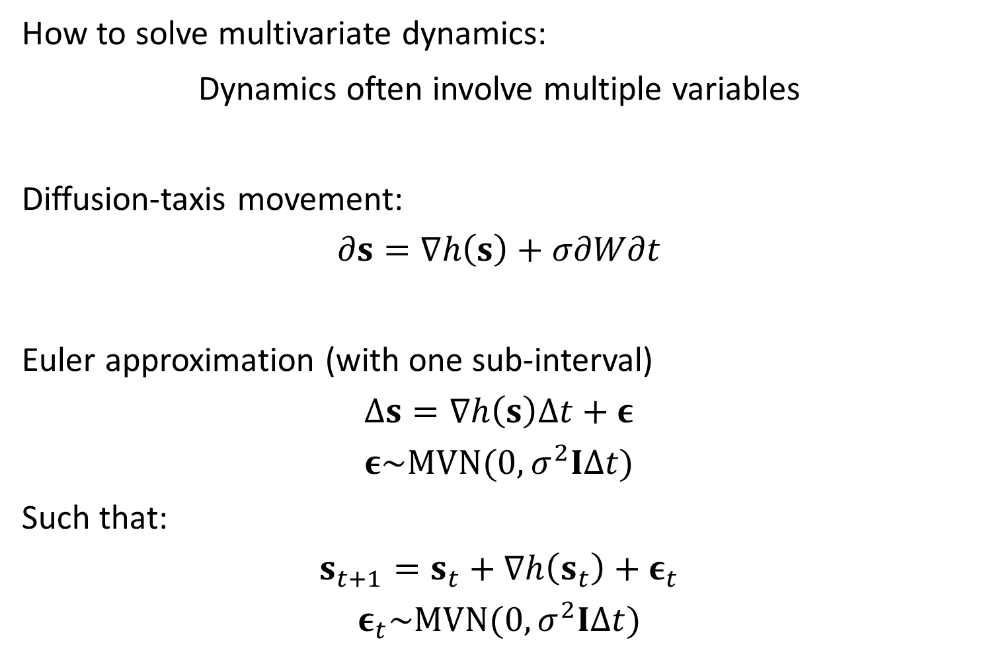
Multivariate models
How to solve multivariate dynamics:
Dynamics often involve multiple variables
Diffusion-taxis movement:
$$∂s=∇h\left(s\right)+σ∂W∂t$$
Euler approximation (with one sub-interval)
$$Δs=∇h\left(s\right)Δt+ε$$
$$ε\sim MVN(0,σ^{2}IΔt)$$
Such that:
$$s_{t+1}=s_{t}+∇h\left(s_{t}\right)+ε_{t}$$
$$ε_{t}\sim MVN(0,σ^{2}IΔt)$$

Slide 5
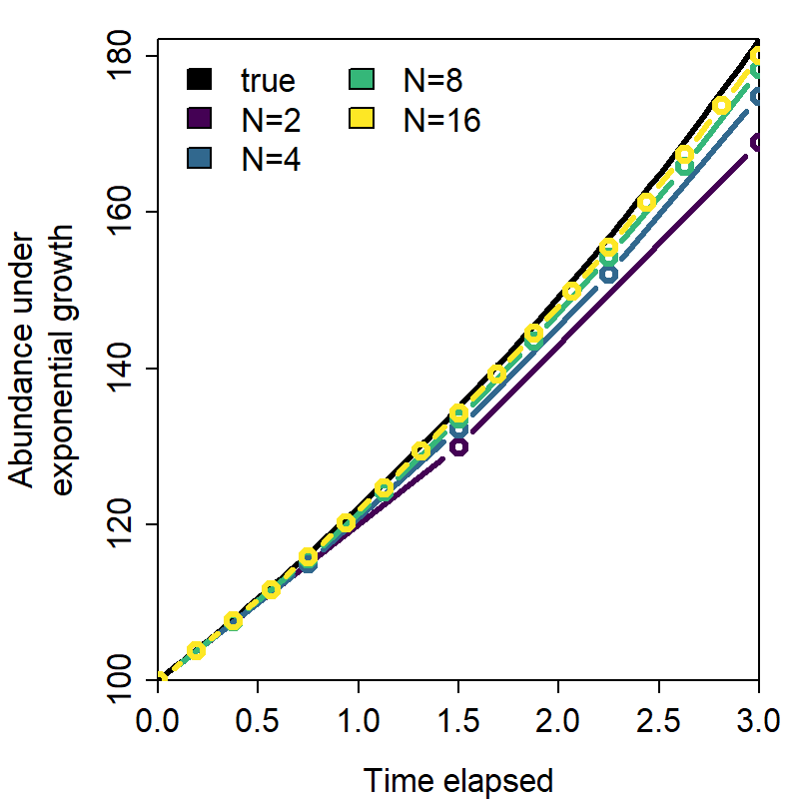
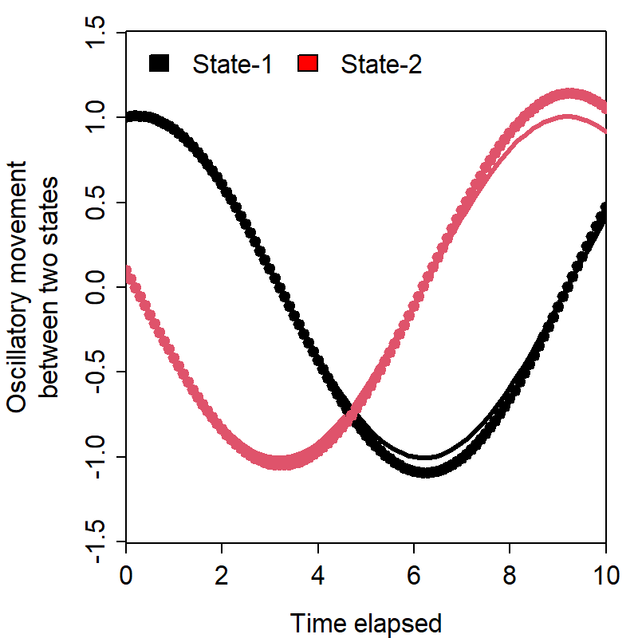


Multivariate models
Euler approximation gets better with more sub-intervals
Exponential growth
$$δN=αN×δt$$
$$N\left(t\right)=N\left(0\right)e^{αt}$$
Lotka-Volterra
$$δX=\left(αX+βY\right)δt \\ δY=\left(γX+θY\right)δt$$

Slide 6

Multivariate models
Rotations for factor models
Dynamic factor analysis
$$y_{t}\sim MVN\left(α+x_{t},V\right) \\ x_{t+1}=x_{t}+Lε_{t}$$
$$ε_{t}\sim MVN(0,I)$$
Or written differently:
$$ε_{t+1}\sim MVN(ε_{t},I)$$
$$x_{t}=Lε_{t}$$
$$(y_{t}−α)\sim MVN\left(x_{t},V\right)$$
Rotations:
$$x_{t+1}=x_{t}+LH^{−1}Hε_{t}$$
And then interpret:
$$L^{∗}=LH^{−1}$$
$$ε_{t}^{∗}=Hε_{t}$$
Where:
$$x_{t+1}=x_{t}+L^{∗}ε_{t}^{∗}$$
And rotation $H$ is calculated as:
Varimax – Associate each factor with as few responses as possible
“PCA” – Associate first factor with maximum variance, second with most variance conditional on 1st, etc

